Slide 2

Marshall Nicholas
Sr Data Scientist, Chargebee

Slide 3

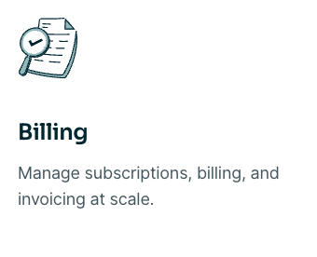
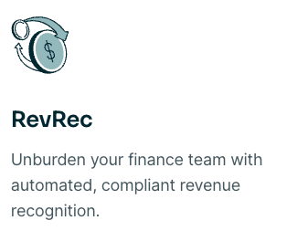
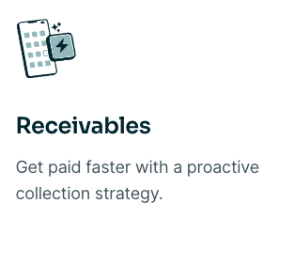
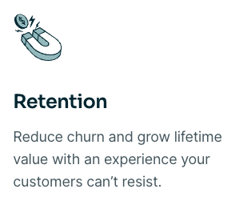
Chargebee is the leading Revenue Growth Management (RGM) platform for subscription businesses
Products
Notes:
Chargebee’s solutions include subscription management and billing, pricing and revenue optimization, revenue recognition, collections, and retention — are modular, and subscription businesses can use them together or individually to power and scale their financial operations at any stage of growth, from startups to enterprises.

Slide 4
Boosting SaaS Success
Exploring the Potential of ML & AI for Churn Prediction & Customer Support

Slide 5
Key Decision
Model Training
Model Inference (Prediction)
Business Operations
Churn Prediction of Business customers
Static (Precomputed Predictions in batch)- Latency not an issue
Static (Retraining on demand)
Complexity
Product Feature
Recommendation Engine for 100000 customers at 1M touchpoints per day
Dynamic (Retraining auto-triggered)
Dynamic (Real Time Predictions)-Latency an issue
Determines the architecture for MLOPs (Maturity Level)
Notes:
Use Apache Beam or Spark if the input needs pre-processing before prediction
Apache Beam is if the client code needs to maintain state. A common reason that the client needs to maintain
state is if one of the inputs to the ML model is a time-windowed average.

Slide 6
Churn Prediction

Slide 7
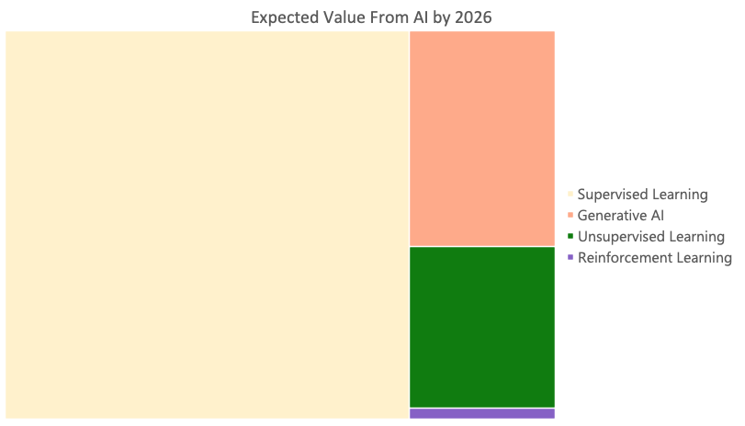
Source: Andrew Ng’s Stanford discussion: Opportunities in AI - 2023

Slide 8
Complexity Tiers
Complexity
Level 1
Level 2
Level 3
Predict churns effectively efficiently
as early as possible
Predict preventable churns effectively and as early as possible
Predict churns effectively
Optimize as a
Standard ML Problem
Optimize for early signals
Optimize for churn intervention strategy based on feedback loop
Performance Evaluation
Recall
Precision
Performance Evaluation
Temporal Recall (How many churns 6 months down the line are predicted today?)
Performance Evaluation
$ Impact of Preventing Churn

Slide 9
Why Churn Prediction is difficult?
Training Data : Account/User + Observation Date
Steep decline in Product Usage
User 1 churn- 3 weeks after churn indicator
User 1 and User 2 behaviors are completely different
Challenges
Variable Latency between User activity and Ground Truth Label confirmation
Different Users use Product at different scale

Slide 10
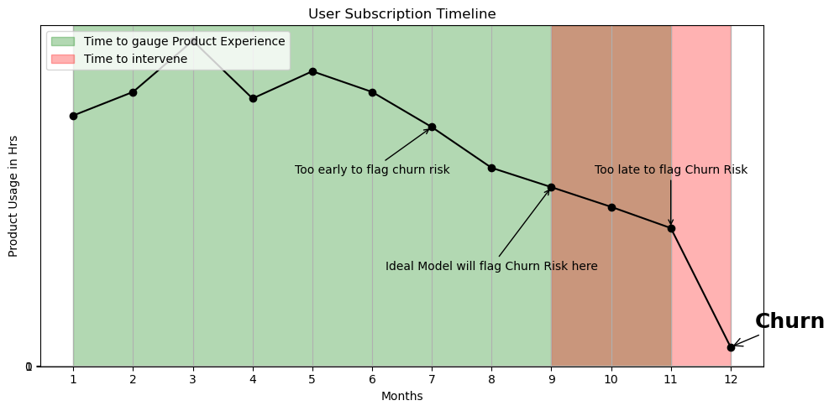
Why Churn Prediction is difficult?
3) Sufficient Period to Gauge Product Experience vs Flagging Churn Risk as early as possible

Slide 11
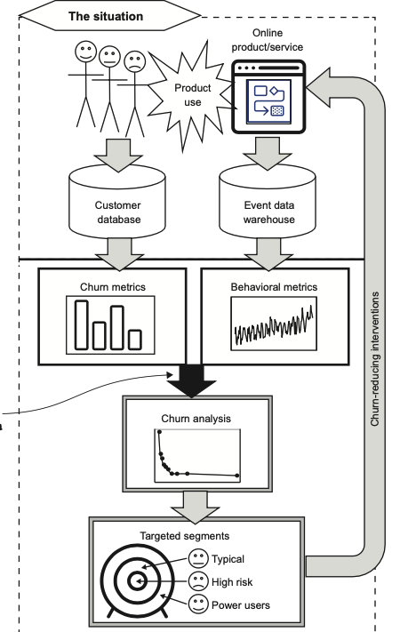
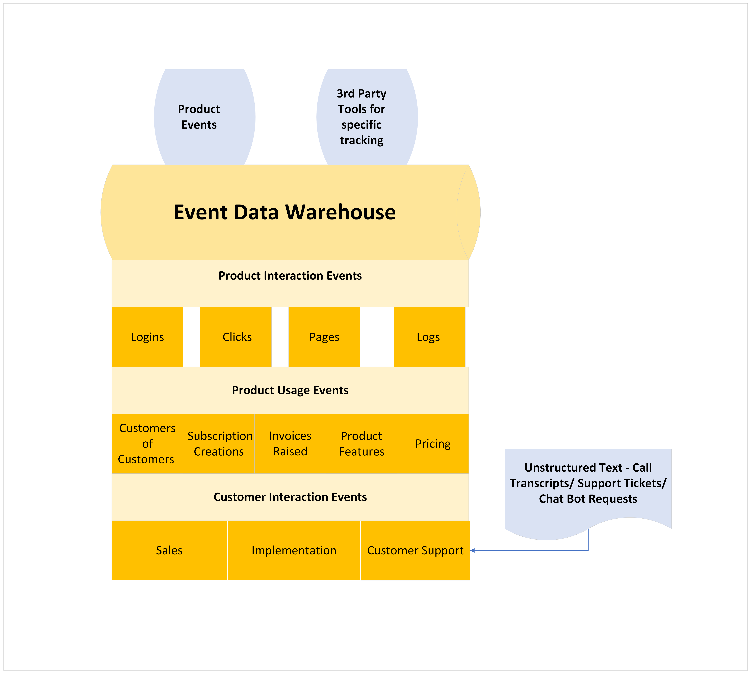
Process Flow
Source: Fighting Churn with Data by Carl Gold

Slide 12
Features

Slide 13
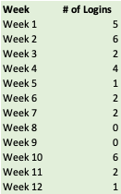
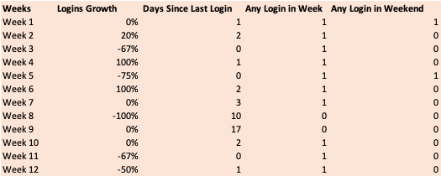
Is Feature Engineering even relevant today?
Raw Data
Aggregation
Engineered Features

Slide 14
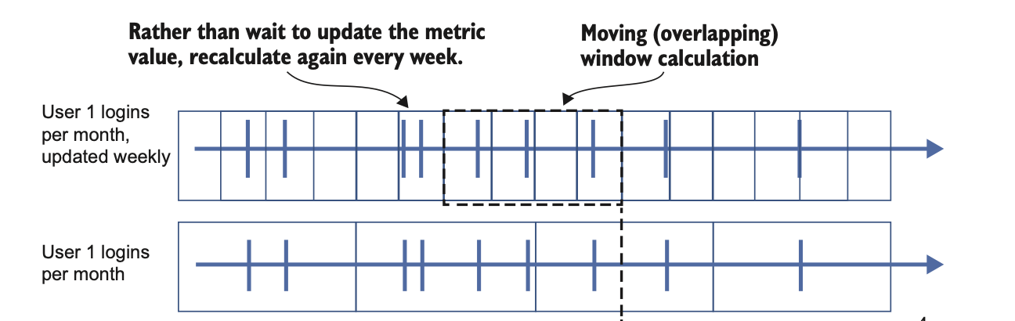

How to convert Product Events to Feature Metrics ?
Month 1
Month 2
Month 3
Month 4
Use Rolling Window Measurements
Metrics Observed every week
Aggregated for 4 weeks

Slide 15
Feature Examples
Best :
Metrics that measure core utility offered by the product
Serves as the best proxy for user engagement
Example For a Netflix User (# of Streaming Minutes)
Metrics that measure negative behavior (Payment Behavior)
Netflix User not updating Card Details
Overrated :
1. Demographics
Can also have impact on Responsible AI
Very Useful :
Metrics that capture rarely occurring events that have high correlation with churn
Example a Netflix User repeatedly checking the account pricing page for cancellation
Notes:
Loosely speaking, the universal approximation theorems say that, given enough parameters, a neural network can get as close to a decent function as you want
Need for interpretable features whose properties are well-adapted to the ML Problem- Helps reduce complexity and converge faster

Slide 16
Challenges Best Practices
Drift
Feedback Loops
Segmenting Customers
Explainability
Precision vs Recall Tradeoff

Slide 17
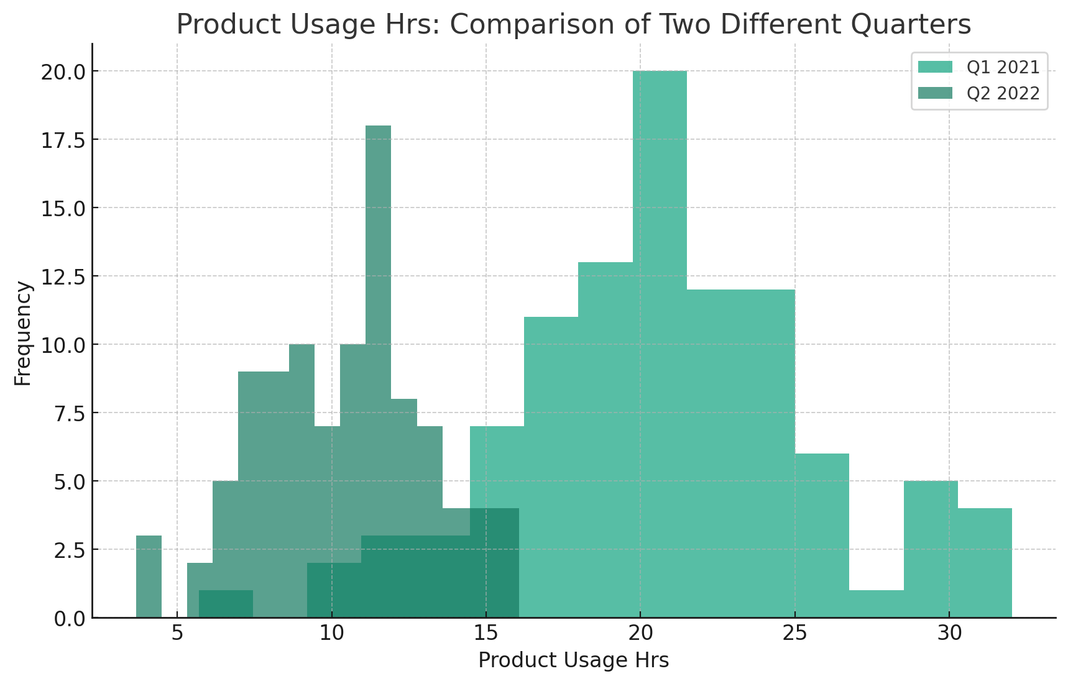
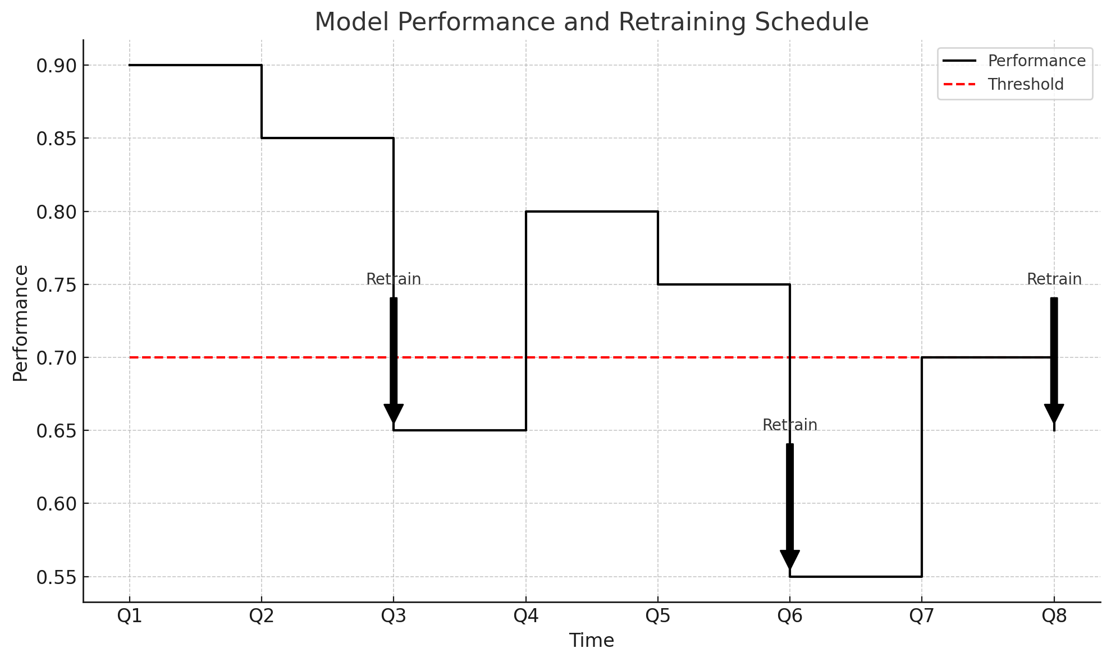
Drift
Solution
1) Before Prediction: Monitor Distribution of Key Features
1
Scenario:
Economic Downturn has meant the product usage metrics has reduced across all users.
The total churns predicted drastically increases.
The ground truth labels for churns are unavailable immediately and model performance cannot be evaluated
How do we accommodate for the new business reality?
 | Total Churns Predicted | Actual Churns
Before | 100 | 90
After | 200 | ?
2) After Ground Truth Labels Available: Scheduled Retraining / Retraining by Trigger
Problem:
Data Drift
Concept Drift
Best Practice
Train Model on Stale Data vs Recent Data to see the impact of drift
Notes:
Cloud Function based triggers can be used
When developing machine learning models, there is an implicit assumption that the train, validation, and test data come from the same distribution
With a higher, more sensitive threshold, models in production remain fresh, but there is a higher cost for frequent retraining as well as technical overhead of maintaining and switching between different model versions. With a lower threshold, training costs decrease but models in production are more stale.
this assumption implies that future data will be similar to past data
So how often should you schedule retraining? The timeline for retraining will depend on the business use case, prevalence of new data, and the cost (in time and money) of executing the retraining pipeline
Data Drift
Monitor distribution of key features across time
Domain Expertise Integration: Work with domain experts who understand the impacts of economic recessions on your specific industry. Their insights can guide the selection of features, the interpretation of data, and the overall strategy for model adjustment.

Slide 18
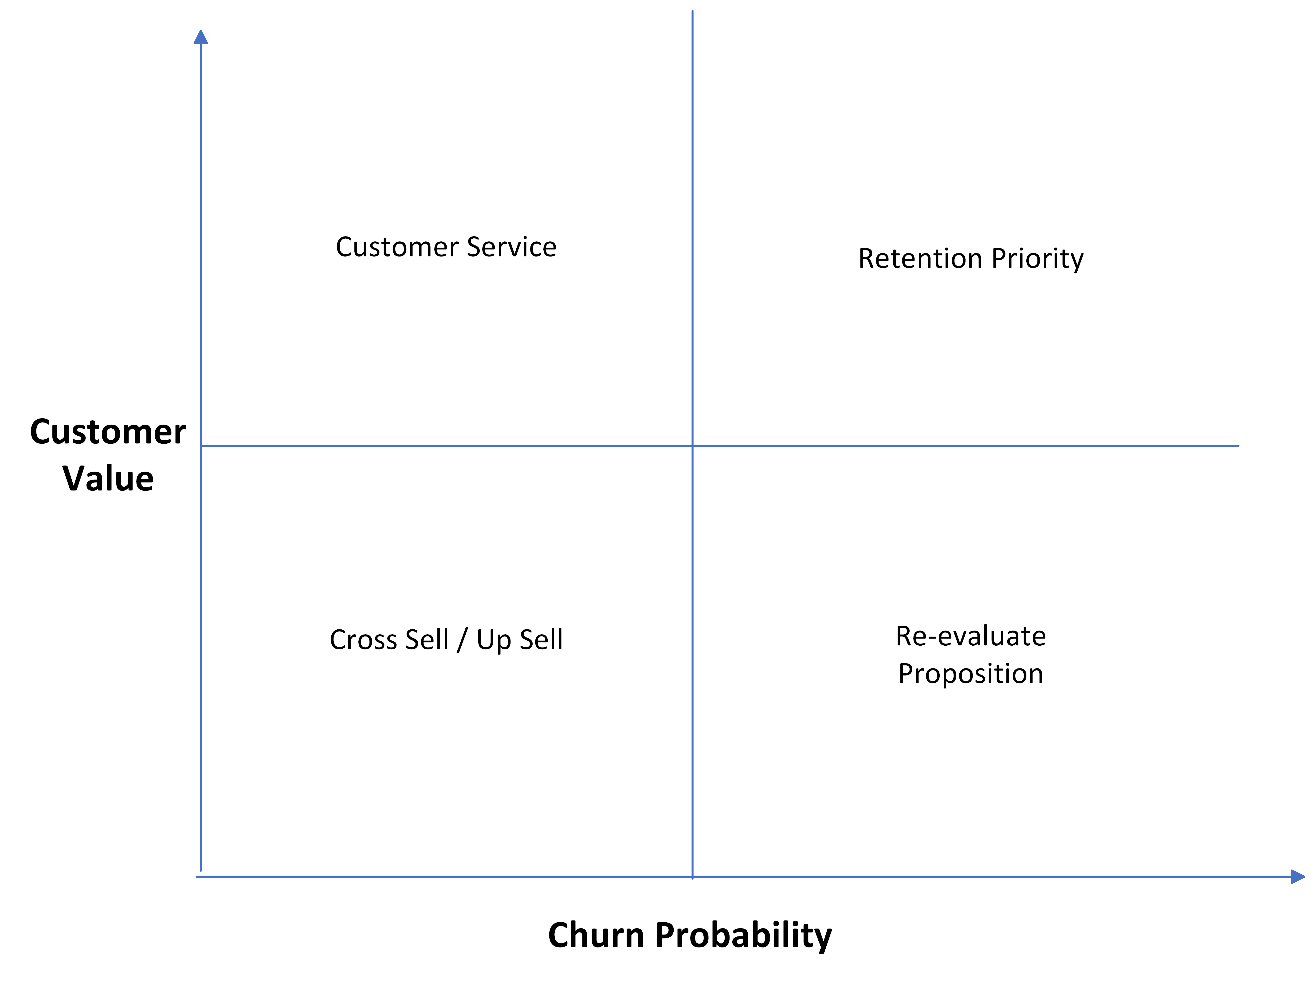
Segmenting Customers
Solution
2
Scenario:
High Value customers are usually high engagement customers. They are less likely to churn
Low engagement customers are more likely to churn but are usually of low value to business
Problem
Different segment of customers have different product usage behaviors and churn Rates.
Cascading of Models
Segmentation
Clustering Techniques to build customer cohorts
Include Model Specific Features
Model 1
Premium Customers/Users
Model 2
High Potential Customers/Users
Model 3
Standard Customers/Users
Prediction Service

Slide 19
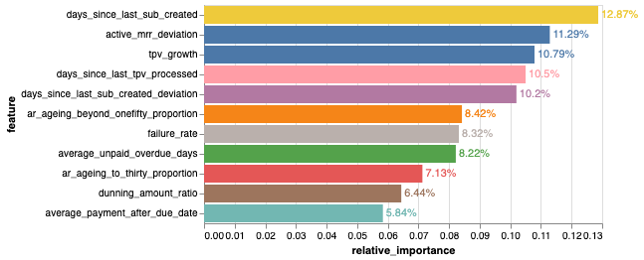
Explainability
3
Solution
Avoid neural networks for simple use cases. Non neural networks have inherent feature attribution built in their respective packages
2) For complex neural networks Use Post-Hoc Explainability Packages like “SHAP”
3) Other options Explainable AI from GCP, Amazon SageMaker Clarify from AWS, Azure Machine Learning Model Explainability
Scenario:
Key decision makers want to know how a model assigned a high churn score to a particular customer.
Problem:
Need explainability/ interpretability from models.
Vital from Bias/Fairness perspective in a B2C setting
Notes:
Neural networks are notorious for operating as a black box

Slide 20
Feedback Loops
4
How Feedback Loops create unforeseen problems?
Model
Model Training
Prediction Service
Churn Predicted
Email, Direct Contact, Deep Discount
Biased Training Data
Churn Intervention Strategy
Left alone model’s performance will be understated
Solution
Remove Intervened Samples from Training
Treat Intervened Samples as Churns after intervention success
Intervention as a feature – to see the effect of different intervention strategies on churn
Notes:
This task of estimating a particular outcome under a different scenario is referred to as counterfactual reasoning and often arises in use cases like fraud detection, medicine, and advertising where a model’s predictions likely lead to some intervention that can obscure learning the actual ground truth for that example.

Slide 21
Precision vs Recall Tradeoff
5
Scenario
Business feels lots of users are flagged as churn risk and they cannot possibly intervene for all
Business feels too many users who are churning are not identified by the model
Business feels high value users are more important to retain
Churn Probability Threshold = 50%
Precision =75% (3/4)
Recall = 43% (3/7)
Problem
What to prioritize when selecting cutoff threshold?
Churn Probability Threshold = 30%
Precision =60% (6/10)
Recall = 86% (6/7)
 | churn probability threshold | Maximizes | Prioritizes
Option 1 | Higher (50%) | Precision | Hit Rate for Prediction
Option 2 | Lower (30%) | Recall | Predict all churns
Notes:
Decreasing the class probability threshold makes the model more sensitive and, therefore, marks more cases as the positive class, which is fraud in this case. This will increase the likelihood of fraud detection. However, it comes at the price of lowering precision.
Cannot control # of (TP+FP)- Explain with example
Solution 3 : Tell how to do ; Create separate models, intoduce penalty for low value merchants in objective function, use Rules of the road post prediction
Cost of a FP vs FN – Optimization based on that

Slide 22
Precision vs Recall Tradeoff
High Value Users
(Low Threshold Criteria = 30%)
Low Value Users
(Higher Threshold Criteria =50%)
Solution 1:
Use Different Thresholds for different Users
30%
70%
Fixed
FP+TP =100
Solution 2:
Evaluate Cost of a FP vs Cost of a FN
FP Cost= Cost of a falsely identifying a churn and intervening
FN Cost = Cost of a missed intervention resulting in customer churn
Determined by domain knowledge
Typically, false intervention costs are low compared to the cost of losing a user to churn
Cost of FN= 3 times Cost of a FP
Option | Cutoff Threshold | FP | FN | Cost
1 | 20% | 34 | 4 | 54
2 | 30% | 23 | 5 | 48
3 | 40% | 16 | 9 | 61
4 | 50% | 12 | 13 | 77
5 | 60% | 12 | 18 | 102
Notes:
Cannot control # of (TP+FP)- Explain with example
Solution 3 : Tell how to do ; Create separate models, intoduce penalty for low value merchants in objective function, use Rules of the road post prediction
Cost of a FP vs FN – Optimization based on that

Slide 23
Customer Support ChatBot

Slide 24
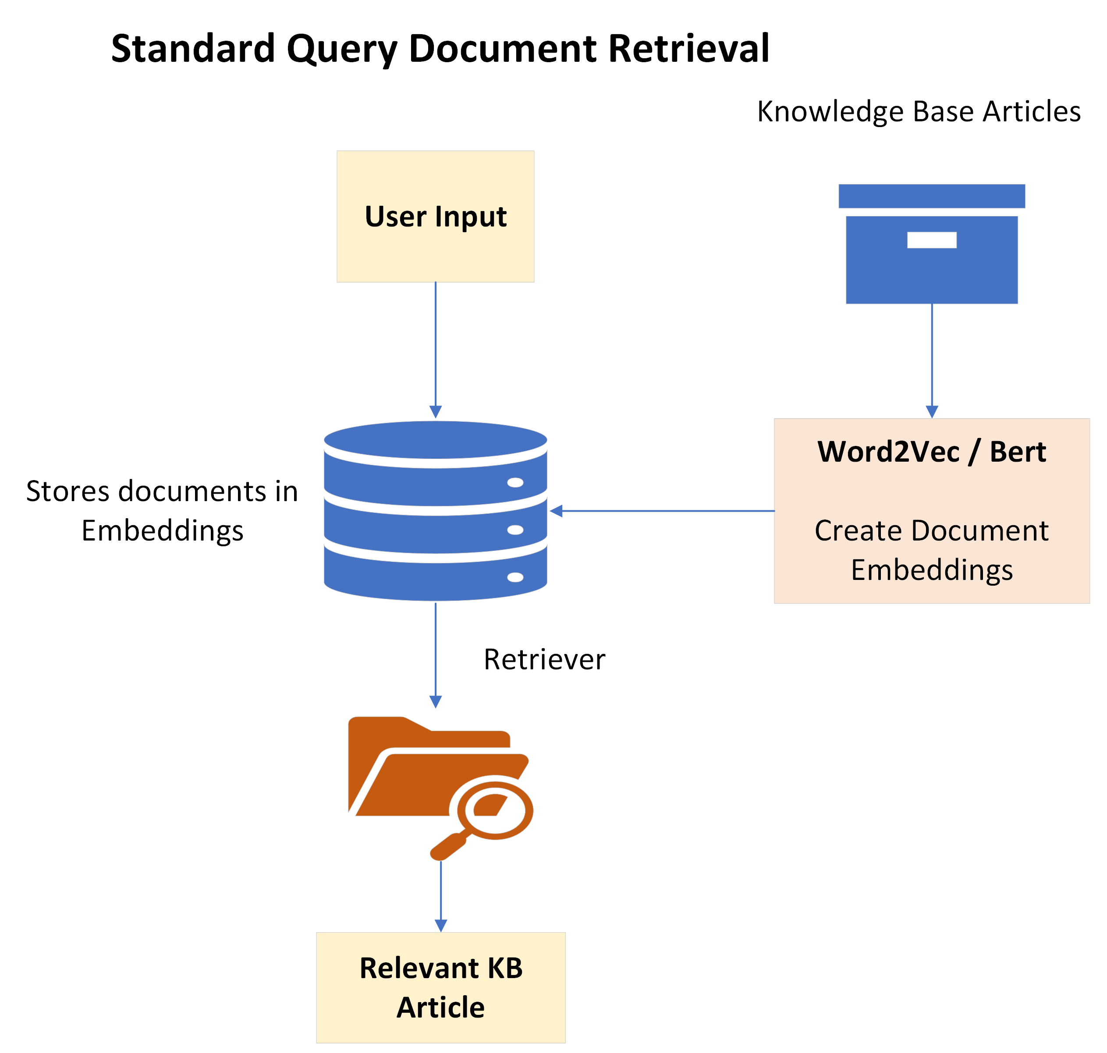
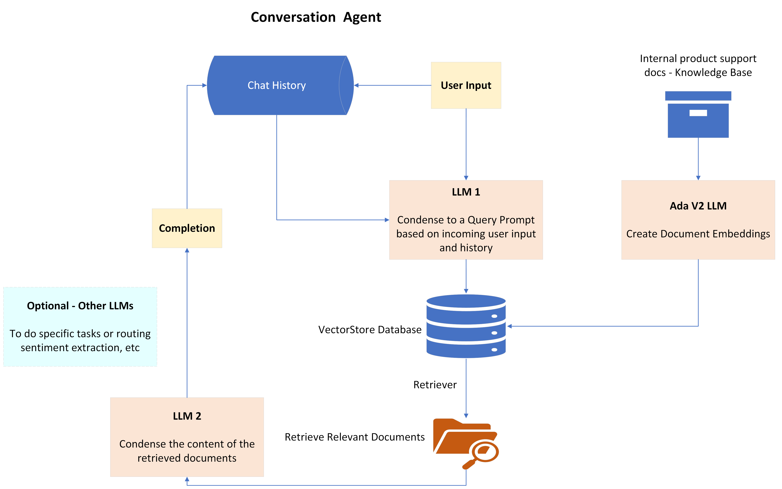
Typical Chatbot
Conversation Agent
KB Articles
KB 1 | How to handle invoice creation? | …….
KB 2 | How to handle subscription creation? | ……..
KB 3 | How to handle subscription cancellation? | ……..
Less Specific Responses
Non- Conversational
Limited failsafe for non-KB queries
More Specific Responses
Conversational
Failsafe exists non-KB queries

Slide 25
Demo

Slide 26
Chief Concerns
Security
Cost & ROI
Reliability
Randomness

Slide 27
Q & A

Slide 28
THANK YOU
Boosting SaaS Success
Marshall Nicholas
Sr Data Scientist Chargebee
Presentation title

Slide 29







Gold Partner
Silver Partner

Slide 30
Appendix

Slide 31
Handling Text Data
Solution:
Multimode representation of text
Embeddings + Bag of Words or (TF-IDF) + Metadata
Customer Support Requests are captured in the form of unstructured free form Text data
Problem
Need to find an approach to extract topic/context/meaning/sentiment from customer interactions and engineer features from it
Notes:
Add a table on support tickets if possible

Slide 32
Bridging Schema
3
Solution
Bridge old data to new schema
Scenario:
“Payment Mode” is one of the key features for churn prediction.
Before: It was either cash or card payment available to the customer (encoded in a binary class).
Now: cash payment is no longer available for customer. Additional info on card payment is available (credit card, debit card, gift card).
Current Distribution of Card Payment
Credit Card | Debit Card | Gift Card
50% | 30% | 20%
Any card payment in historical data, we assign priori probability of new class distribution
Multi-Hot Encoded Values=[0, 0.5, 0.3, 0.2] [Card, Credit, Debit, Gift]
Problem
Data Schema Changes due to Business changes or other factors. One of the key features in the model is no longer available in the expected format
Ensure sufficient representation in training data from samples post schema change
Notes:
How do you retrain the model as you don’t have sufficient training data in new schema?

Slide 33
ML Failures – Large Models
Solution
7
At each epoch, use Model Checkpoints to build partial model states
Problem
When we train computationally heavy neural networks the chances of Machine Failure increases almost linearly with time
Epochs
Learning High Level Organization
Learning Low Level Organization
Overfitting
Checkpoint 1: Early Stopping
Checkpoint 2: Run till Max Epochs
Option 1 | Option 2
Retrain on Fresh data from here from Checkpoint 1 | Complete Retraining on Fresh data
Saves Computing Resources
More Accuracy

Slide 34
Chatbot Options
 | Option 1 | Option 2 | Option 3 | Option 4
 | NLP Word2Vec | Standard Conversation Agent | Option2 + Sentiment Based Response | Fine Tuning Foundational LLMs to Internal Docs
Response | KB Article itself | Summarized Response based on multiple KB Articles | Summarized Response based on multiple KB Articles | Summarized Response based on multiple KB Articles
Context Captured | Unlikely if Query is OOV | Yes | Yes | Yes
Specific Response | No | Yes | Yes | Yes
Cost | Negligible | GPT 4 (2 LLMs) + Ada Embeddings | (GPT 3.5 - 3 LLMs) (Ada V2 - Embeddings) | ~2X Option 2 Cost
KB Effort | KB Articles need constant curating | KB need occasional curating | KB need occasional curating | No need KB curation

